Slide 1

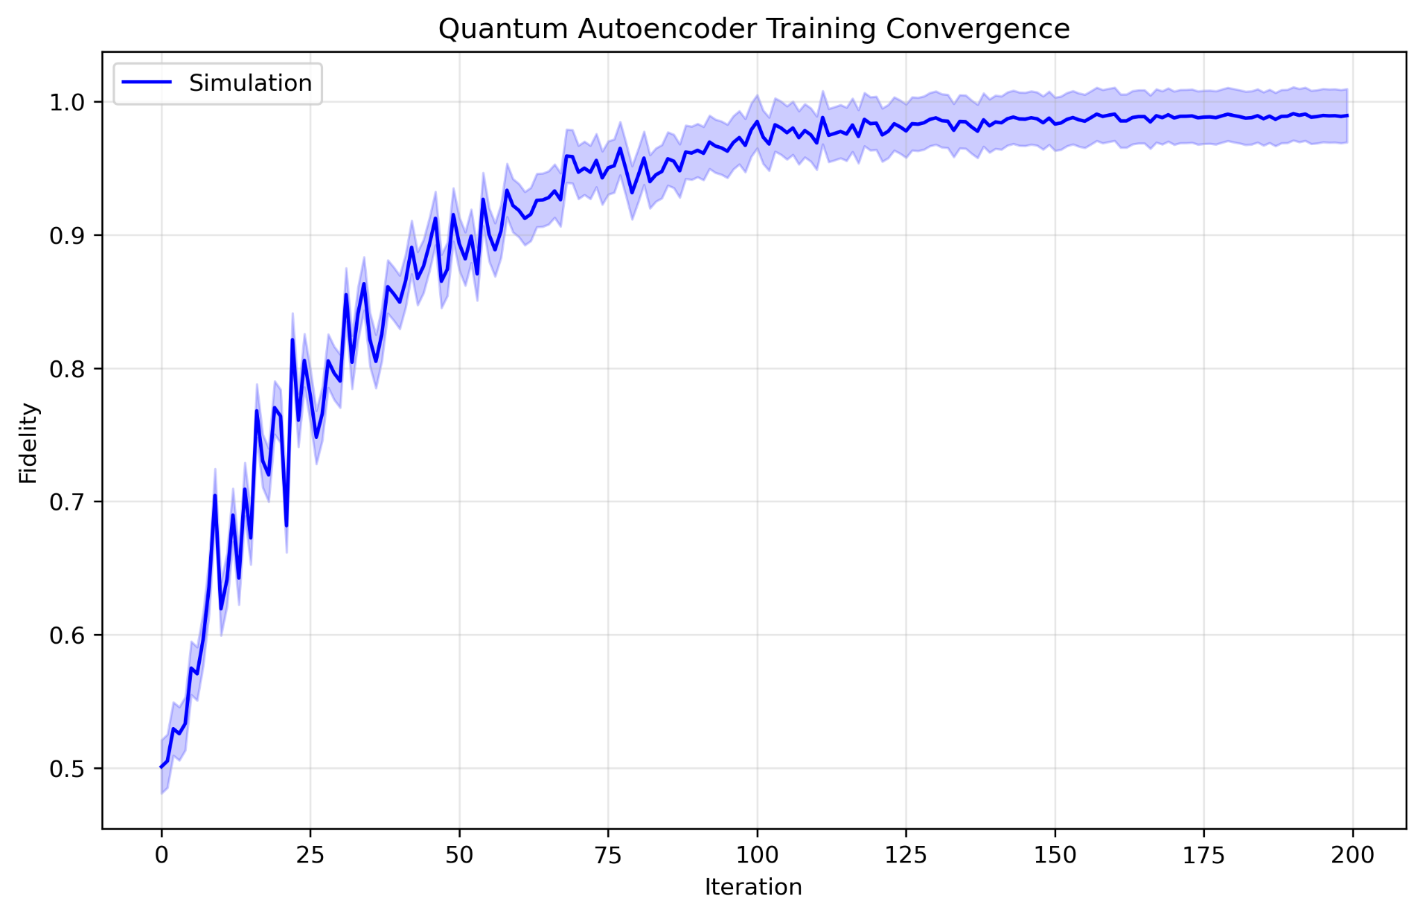
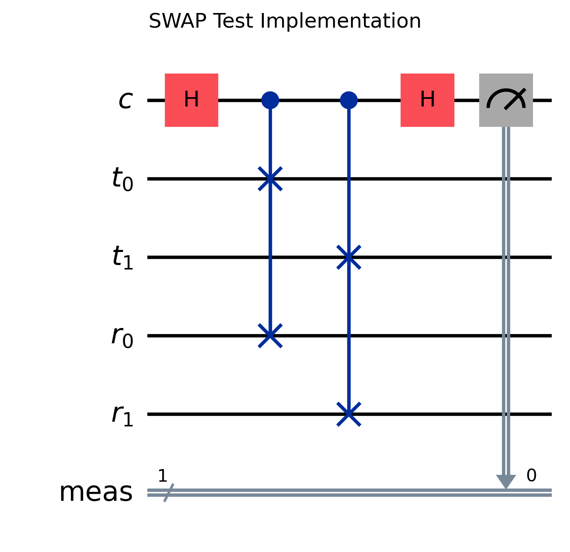
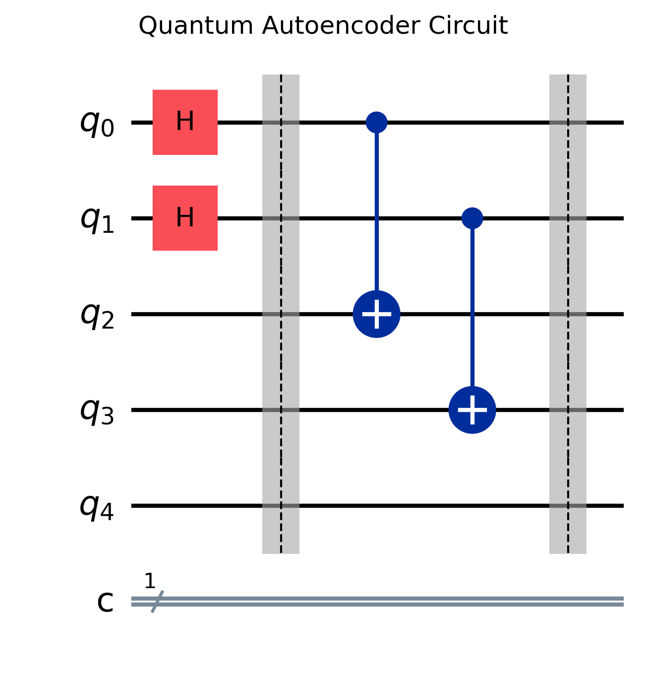
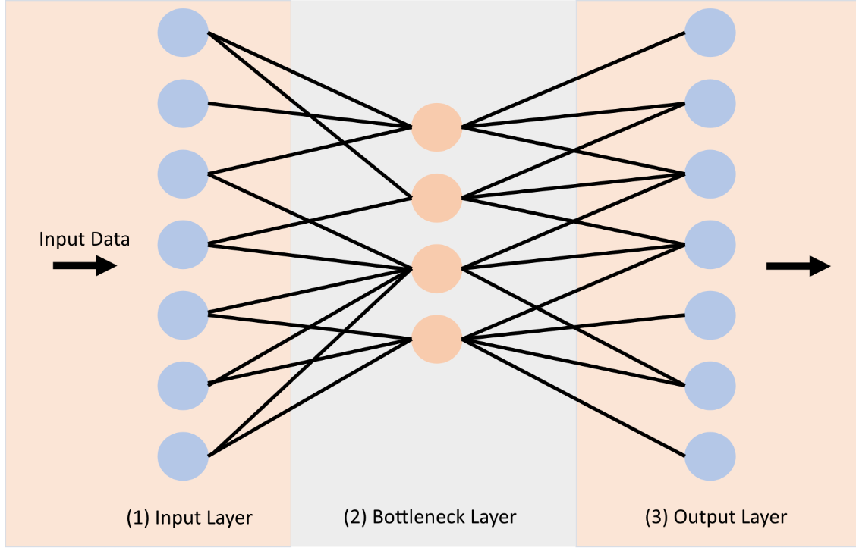
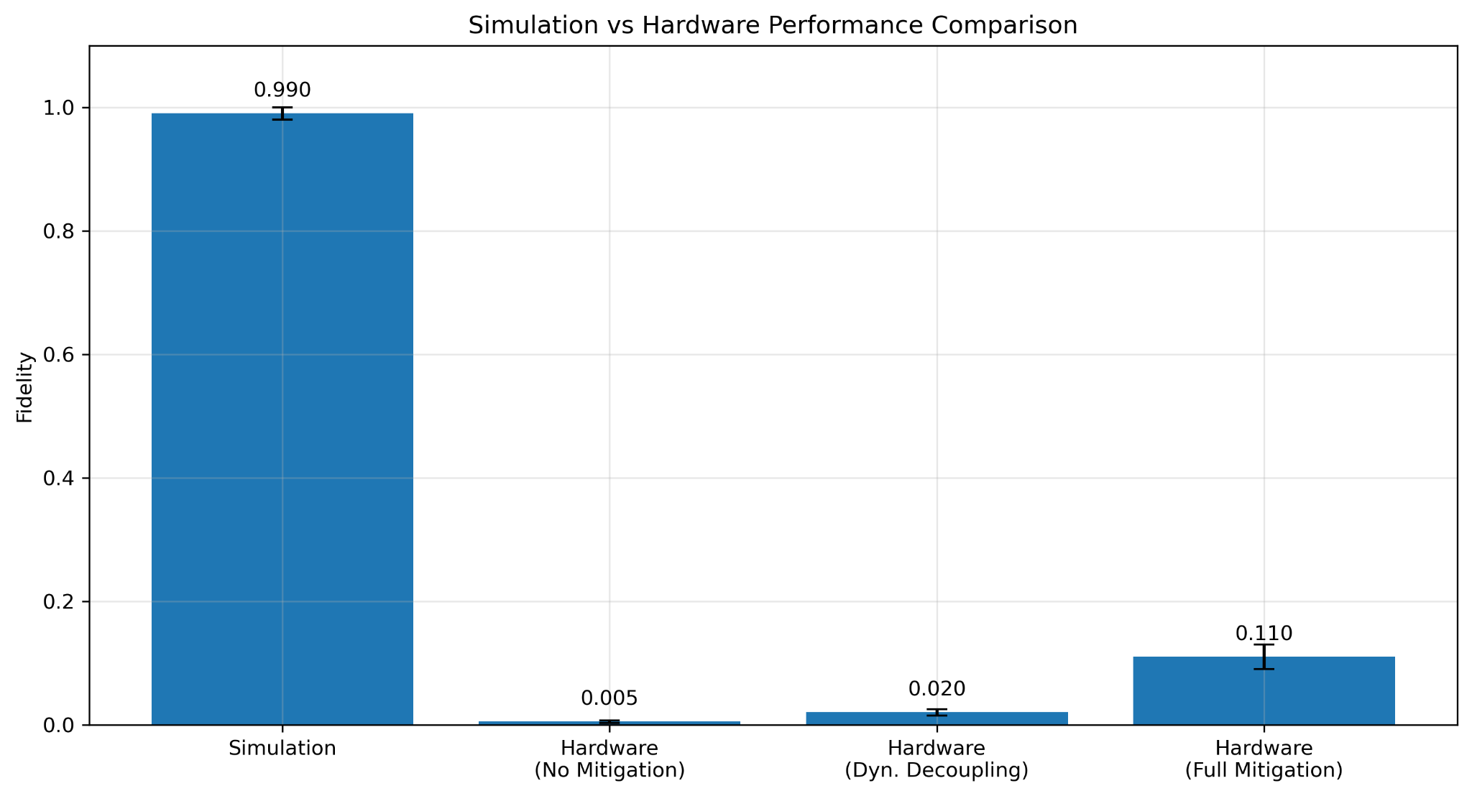
Quantum State Compression: Simulation-Hardware Gap
Cameron Akhtar
Computer Science Undergraduate
Introduction
Results
Methodology
Quantum autoencoders represent a promising intersection of quantum computing and machine learning, offering a pathway to compress quantum information while preserving essential quantum features. This project implements a quantum autoencoder using IBM's Qiskit Runtime V2 primitives, designed to compress a 5-qubit domain wall state |00111⟩ into a 3-qubit latent space while maintaining high fidelity.
Unlike classical autoencoders, quantum autoencoders must preserve quantum properties such as superposition and entanglement during compression. This makes them particularly valuable for quantum state preparation, quantum memory optimization, and quantum error correction applications.
1. Simulation Performance
- Achieved >99% fidelity in ideal simulation
- Successful compression of 5-qubit state into 3 qubits
- Stable convergence after ~150 iterations
- Perfect reconstruction of domain wall state |00111⟩
2. Hardware Implementation Challenges
- Circuit depth increased significantly after transpilation (359-898 gates)
• Original circuit: ~50 gates
• After mapping to hardware: 359-898 gates due to connectivity constraints
- Decoherence time (T1, T2) limitations:
• Hardware coherence time: ~100μs
• Circuit execution time: ~50-70μs
• Quantum state degraded before completion
- Hardware noise accumulation:
• Each additional gate introduces 0.1-1% error
• Multiplicative effect over 359+ gates
• Results in exponential fidelity decay
- Final hardware fidelity: 0.5-11% depending on error mitigation
3. Error Mitigation Analysis
- Dynamical decoupling showed promise but insufficient for deep circuits
- Increased shot count (8192) improved measurement statistics
- Resilience level 1 provided marginal improvements
- Identified need for circuit optimization strategies
4. Key Insights for Future Work
- Circuit depth reduction crucial for NISQ hardware
- Error mitigation needs to be balanced with circuit complexity
- Potential for shallow circuit alternatives
- Importance of hardware-aware circuit design
1. Circuit Design
- 5-qubit input register for domain wall state |00111⟩
- 3-qubit latent space for compressed representation
- RealAmplitudes ansatz for encoder (U) and decoder (V)
- SWAP test circuit for fidelity measurement
2. Optimization Strategy
- SPSA optimizer with 200 iterations
- Learning rate: 0.15, Perturbation: 0.1
- Cost function based on SWAP test fidelity
- Parameter initialization in [0,1] range
3. Error Mitigation
- Dynamical decoupling (XpXm sequence)
- Resilience level 1 enabled
- 8192 shots per measurement
- Optimized circuit transpilation
Hardware Configuration:
- IBM Quantum Kyiv backend
- Native gates: {ecr, id, rz, sx, x}
- Full connectivity between qubits
Summary/Conclusion
1. Successfully demonstrated quantum autoencoder concept in simulation, achieving >99% fidelity for compressing a 5-qubit domain wall state into a 3-qubit latent space.
2. Implementation on IBM Quantum hardware revealed fundamental NISQ-era challenges:
- Circuit transpilation increased gate count by ~10x due to hardware connectivity
- Decoherence effects dominated as circuit execution approached coherence time
- Gate errors accumulated exponentially with circuit depth
- Even with error mitigation, hardware fidelity limited to 11%
3. The project provides valuable insights for quantum algorithm implementation:
- Hardware-aware circuit design is crucial from the start
- Transpilation impact must be considered in initial design
- Error mitigation alone cannot overcome fundamental hardware limitations
- Need for new architectures suited to NISQ constraints
Hypothesis/Question
1. Can we effectively implement a quantum autoencoder using Qiskit Runtime V2 primitives that achieves high-fidelity compression of a 5-qubit domain wall state into a 3-qubit latent space?
2. How does the performance of our quantum autoencoder compare between ideal simulation and real quantum hardware execution?
3. What impact do error mitigation techniques (dynamical decoupling, resilience levels) have on the autoencoder's performance on real quantum hardware?
Expected Outcomes:
- Achieve >90% fidelity in ideal simulation
- Demonstrate successful compression on IBM Quantum hardware with error mitigation
- Establish a framework for quantum data compression using modern Qiskit primitives
References
1. Romero, J., Olson, J. P., & Aspuru-Guzik, A. (2017). Quantum autoencoders for efficient compression of quantum data. Quantum Science and Technology, 2(4), 045001.
2. IBM Quantum (2024). Qiskit Runtime V2 Primitives Documentation. https://qiskit.org/documentation/partners/qiskit_ibm_runtime/
3. Cerezo, M., Poremba, A., Cincio, L., & Coles, P. J. (2020). Variational quantum state diagonalization. npj Quantum Information, 6(1), 1-10.
4. Cross, A. W., Bishop, L. S., Sheldon, S., Nation, P. D., & Gambetta, J. M. (2019). Validating quantum computers using randomized model circuits. Physical Review A, 100(3), 032328.
5. Kandala, A., et al. (2019). Error mitigation extends the computational reach of a noisy quantum processor. Nature, 567(7749), 491-495.
Acknowledgements
I would like to express my deepest gratitude to my mentor, Luke Miller, a graduate Computer Science student at UMKC and officer of the QSAIC. His expertise, guidance, and unwavering support were instrumental in bringing this project to fruition. Luke's passion for computer science not only inspired me to undertake this challenge but his insights and encouragement were crucial throughout the development process. His willingness to share his knowledge and time has profoundly impacted both this project and my growth as a student. I am truly fortunate to have had such a dedicated mentor whose influence extends far beyond the technical aspects of this work.

